Slide 1
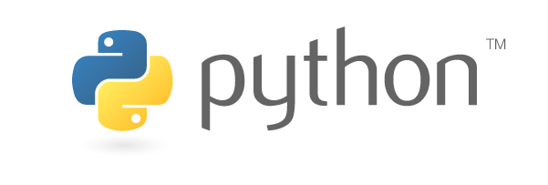
ARRAY

Slide 2
SESSION OVERVIEW:
DEFINITION
CREATION
METHODS & BUILT-IN FUNCTIONS

Slide 3

DEFINITION
An Array is a Data Structure that Stores values of Same data type.
This is the Main difference Array & List.
To use Arrays in Python , we need import the standard ‘array’ Module.
Because Array is not a Basic or Fundamental Datatype in Python like List, tuple, etc.

Slide 4

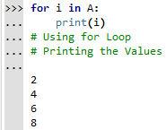
SYNTAX :
<array_name> = array(typecode,[element1,element2,…..])

Slide 5
Typecode : The Datatype
Data Type | Type Code | Size in Bytes
Char | c | 1
Int | i | 2
Float | f | 4
Methods :
Append()
Insert()
Extend()
Remove()
Pop()
Index()
Reverse()
Count()

Slide 6
ARRAY METHODS
From list() – Add Items from List to Array
To list() – Convert Array into List
Buffer_info() – Address in Memory & Size of Array
From string() – Add a String to Char Array
To string() - Convert Array into String

Slide 7

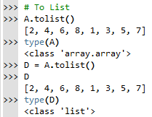
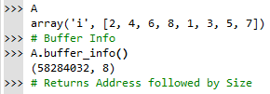

Slide 8

CODING IS FUN ! THANK YOU !!

